Slide 1
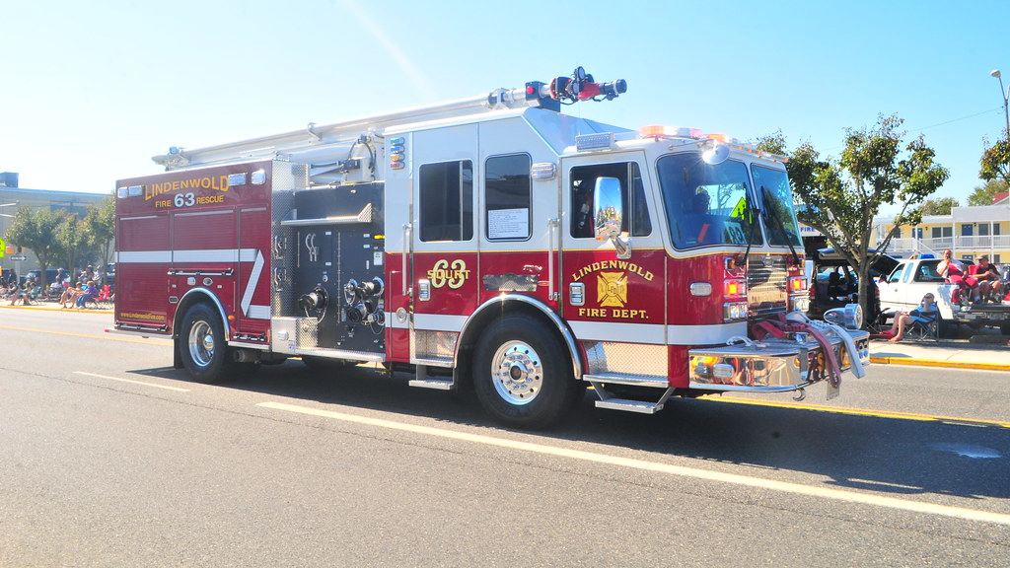
LINDENWOLD FIRE DEPARTMENT
RCA INTRO
EXISTING CONDITIONS
DEFFINCIENCIES
NEEDS ASSESSMENT
SOLUTION
CONCLUSION

Slide 2
LOCATION AND EXPERIENCE
RCA INTRO
Location:
Robbie Conley Architect, LLC.
596 Glassboro Road
Woodbury Heights, NJ
Experience:
Fire Service: 40 Years
Architectural: 36 Years
Chief of Woodbury Heights Fire Department: 10 Years
Councilman: 3 Years
Mayor of Woodbury Heights: 4 Years
Substantial Experience in Public Work, EMS & Fire

Slide 3
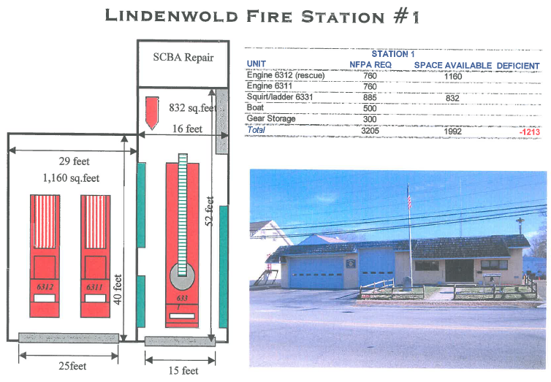
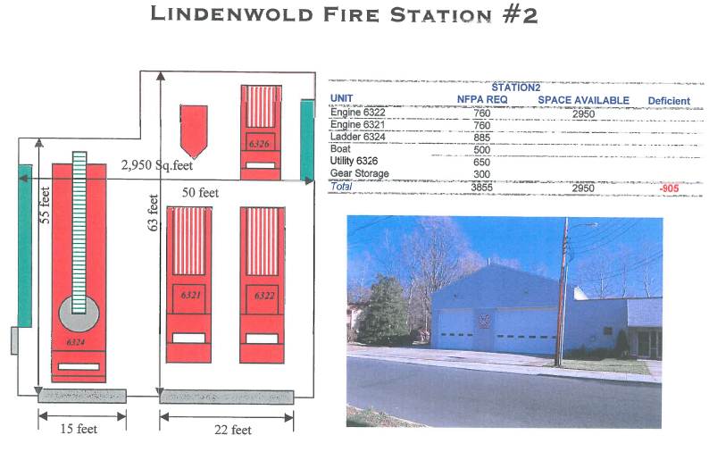
EXISTING CONDITIONS
EXISTING CONDITIONS

Slide 4
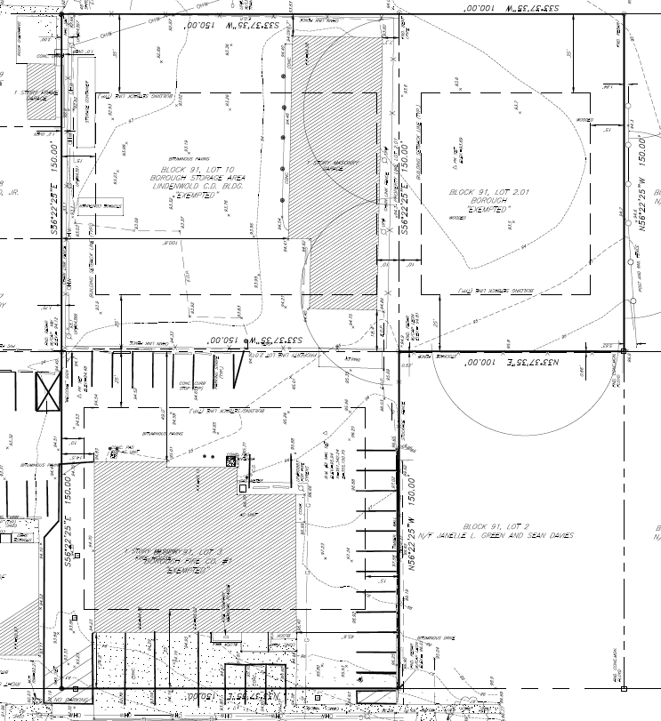
EXISTING CONDITIONS
EXISTING CONDITIONS

Slide 5
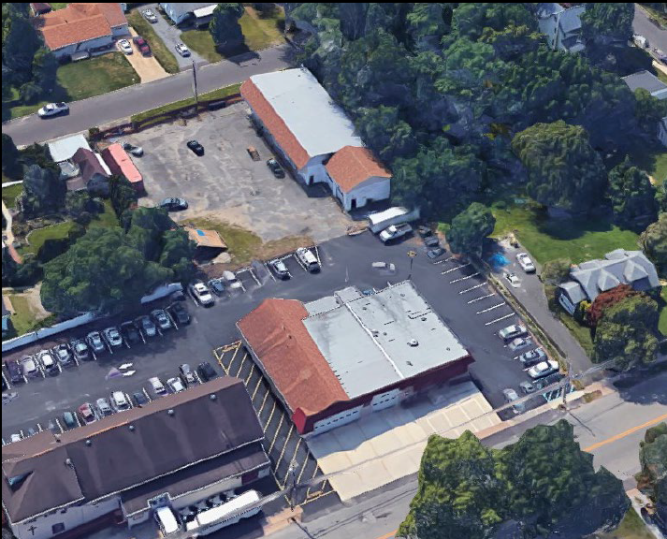
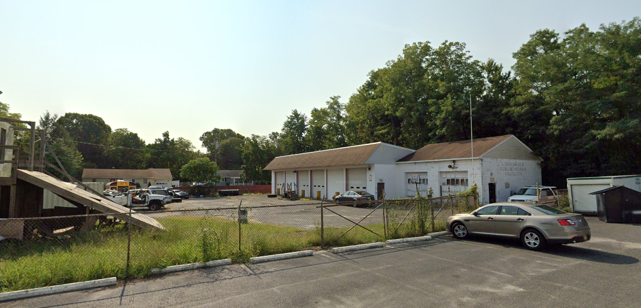
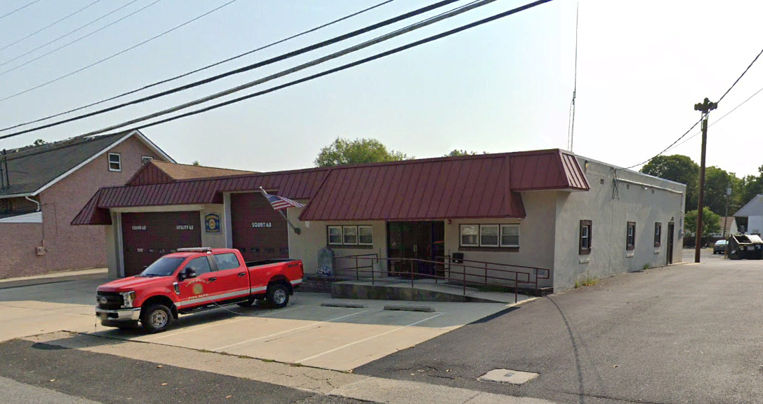
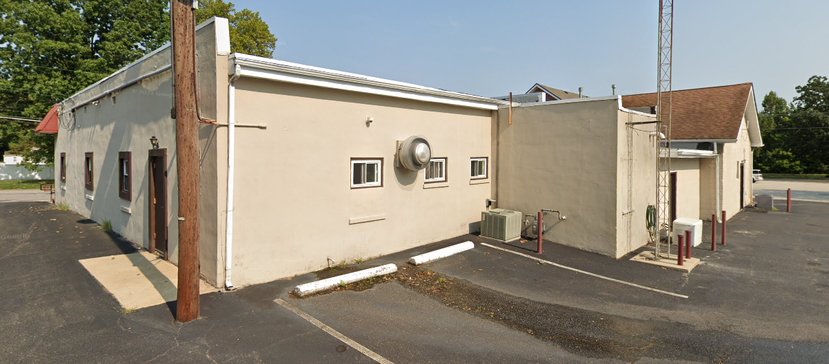
EXISTING CONDITIONS
EXISTING CONDITIONS

Slide 6
DEFICIENCIES
Deficiencies in the existing facilities are outlined in Chapter 8 of the Report as prepared by Fire Technical Services in 2007.
Evaluation methods and operational deficiencies are outlined in Chapters 2 through 7 of the Report listed above and may be available from Lindenwold Fire District No. 1 upon request.
Reviewed and Concured by Robbie Conley Architect.
DEFICIENCIES

Slide 7
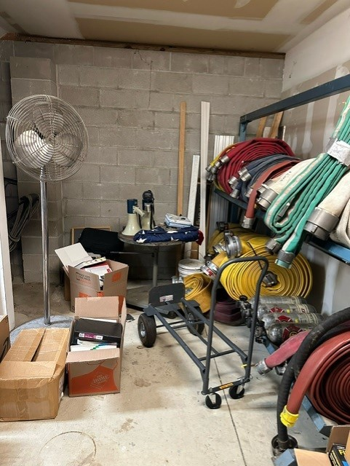
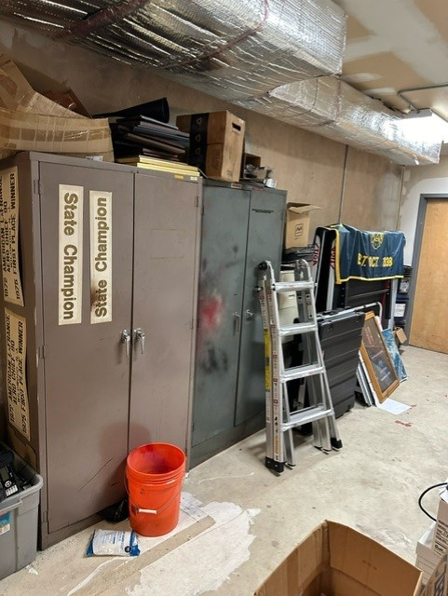
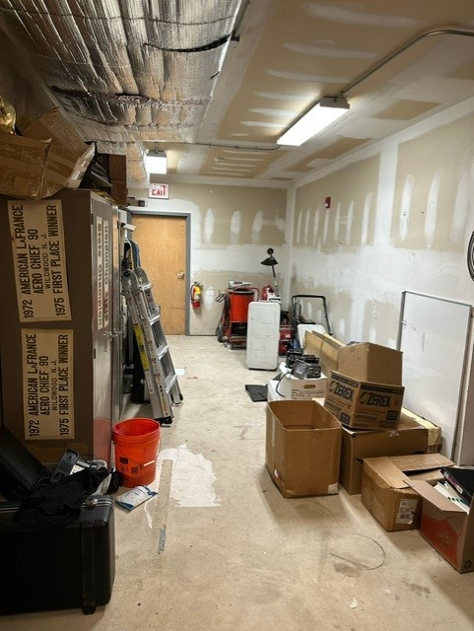
DEFICIENCIES
DEFICIENCIES

Slide 8
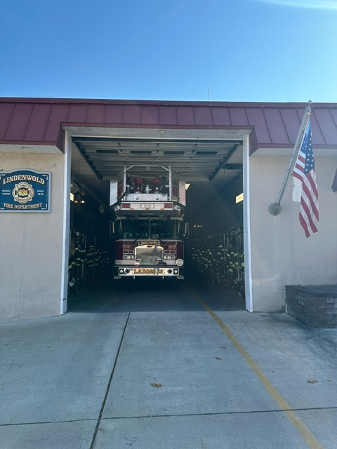
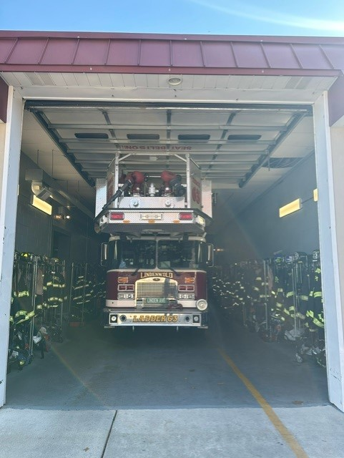
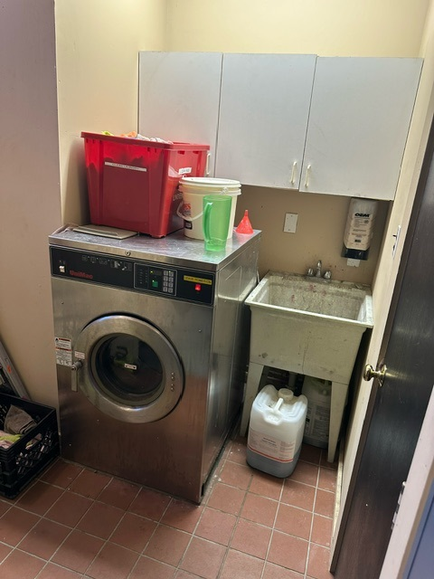
DEFICIENCIES
DEFICIENCIES

Slide 9
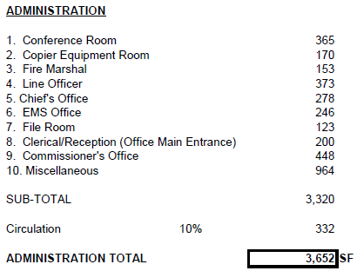
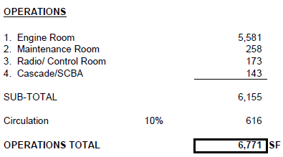
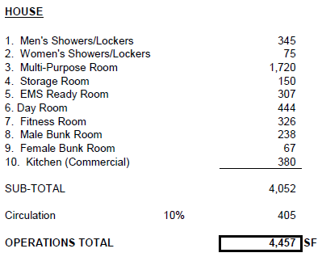
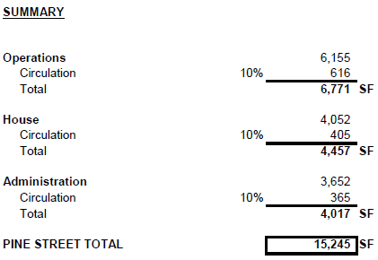
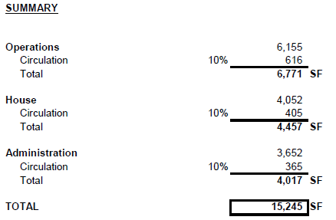
NEEDS
NEEDS

Slide 10
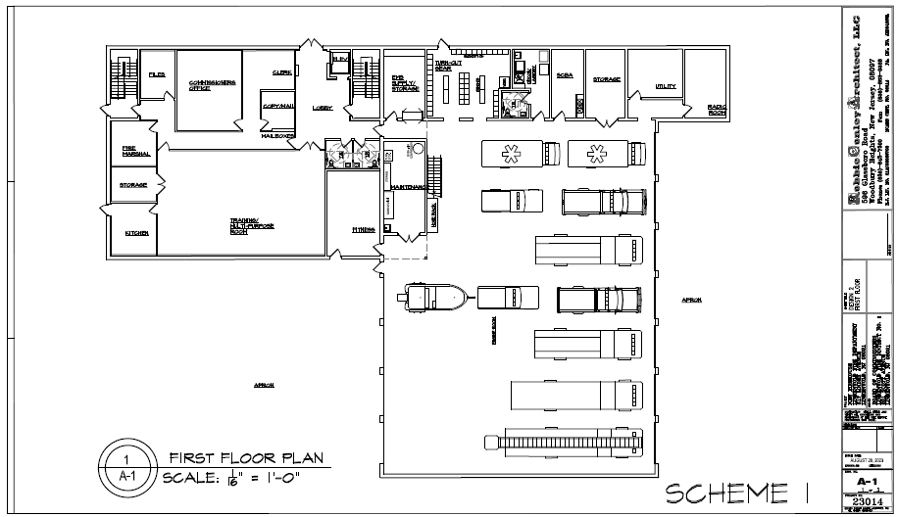
SCHEME 1
SOLUTIONS

Slide 11
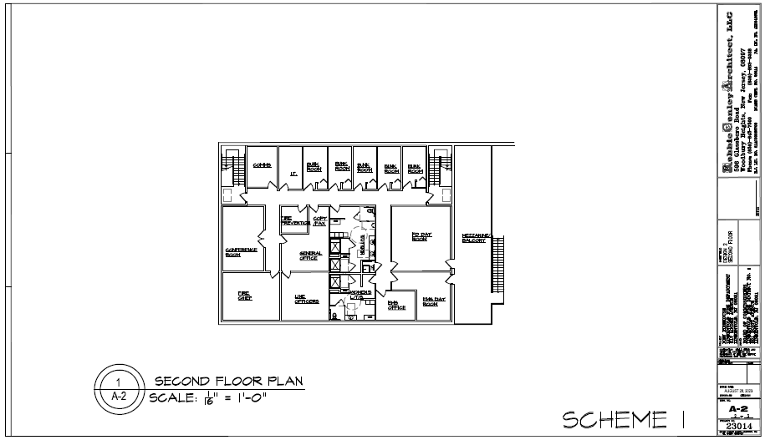
SCHEME 1
SOLUTIONS

Slide 12
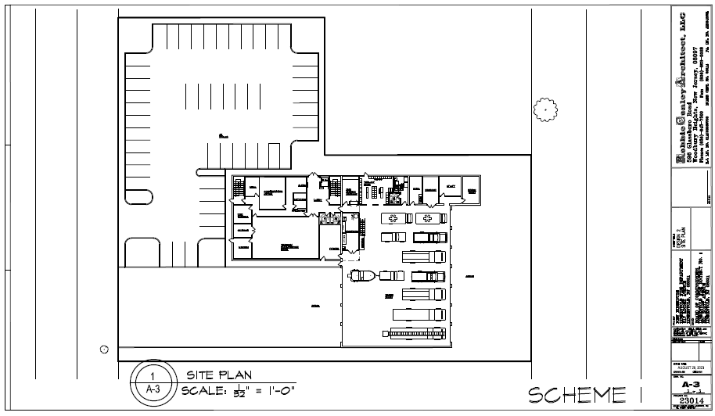
SCHEME 1
SOLUTIONS

Slide 13
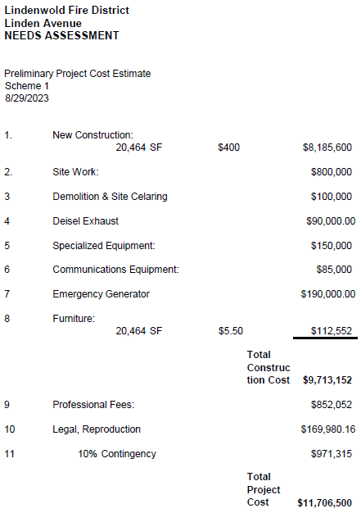
SCHEME 1
SOLUTIONS

Slide 14
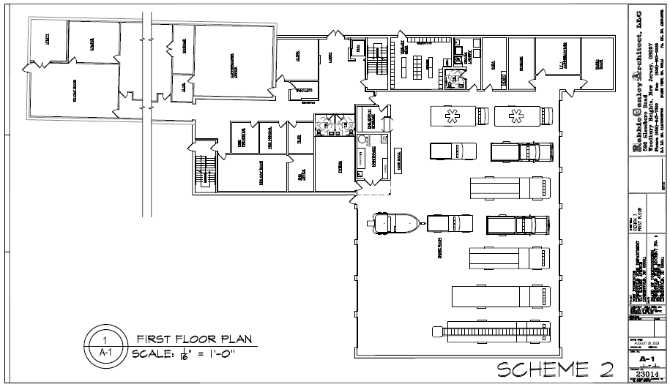
SCHEME 2
SOLUTIONS

Slide 15
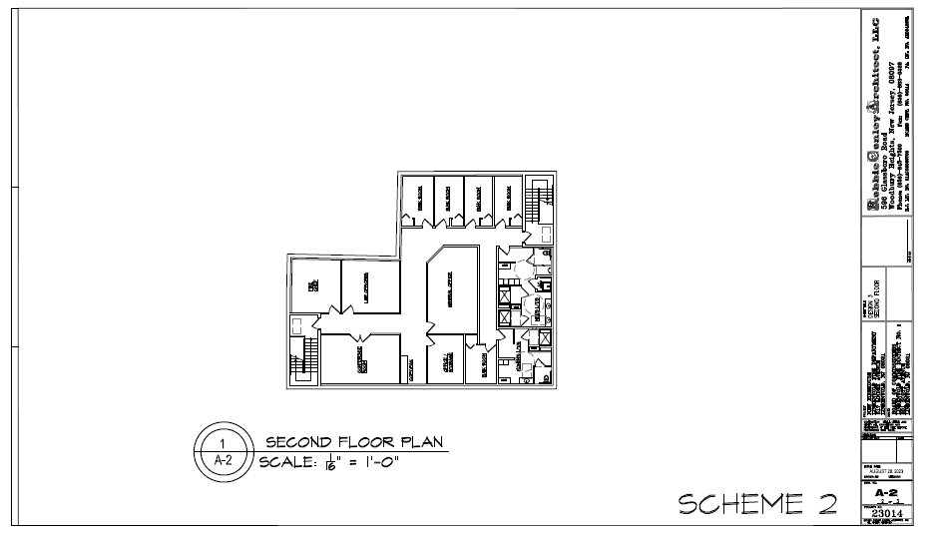
SCHEME 2
SOLUTIONS

Slide 16
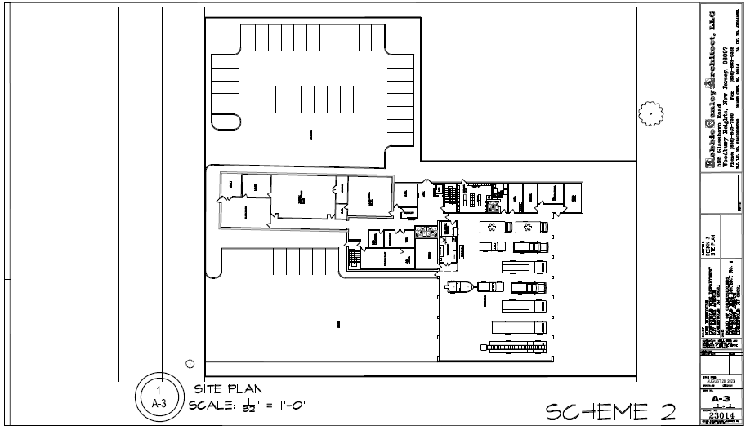
SCHEME 2
SOLUTIONS

Slide 17
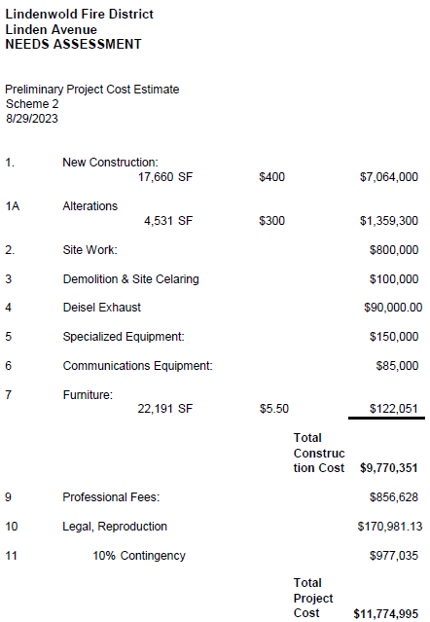
SCHEME 2
SOLUTIONS

Slide 18
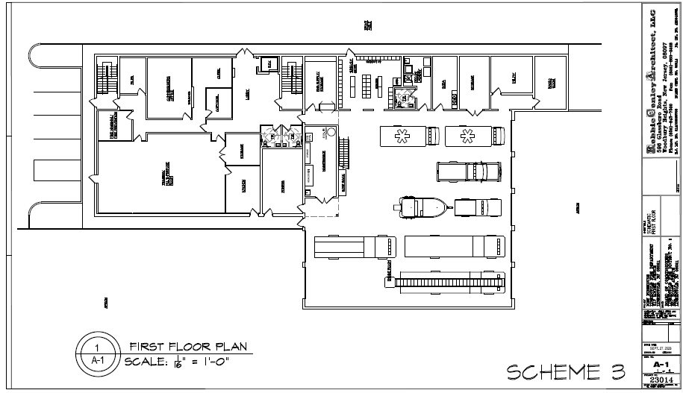
SCHEME 3
SOLUTIONS

Slide 19
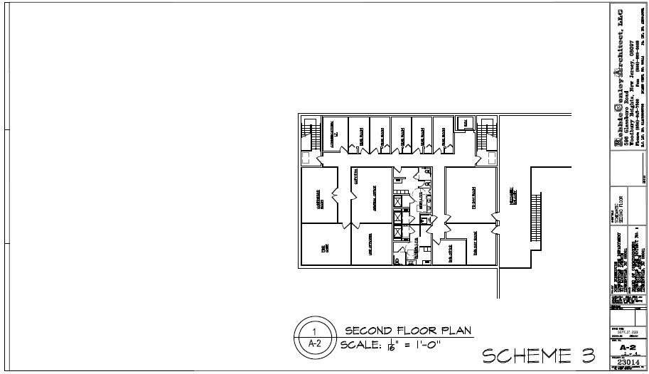
SCHEME 3
SOLUTIONS

Slide 20
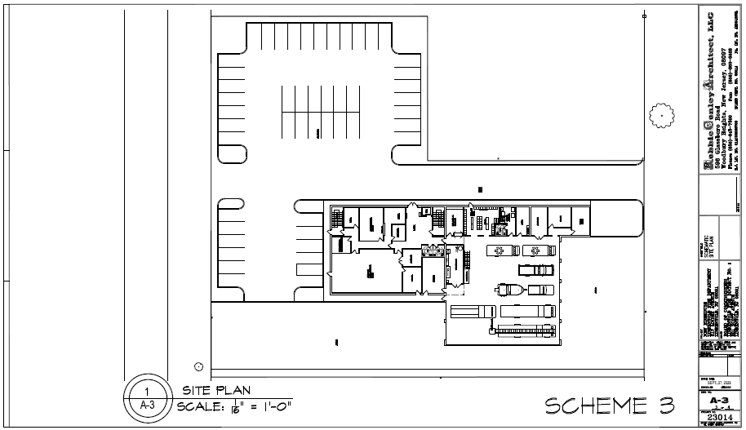
SCHEME 3
SOLUTIONS

Slide 21
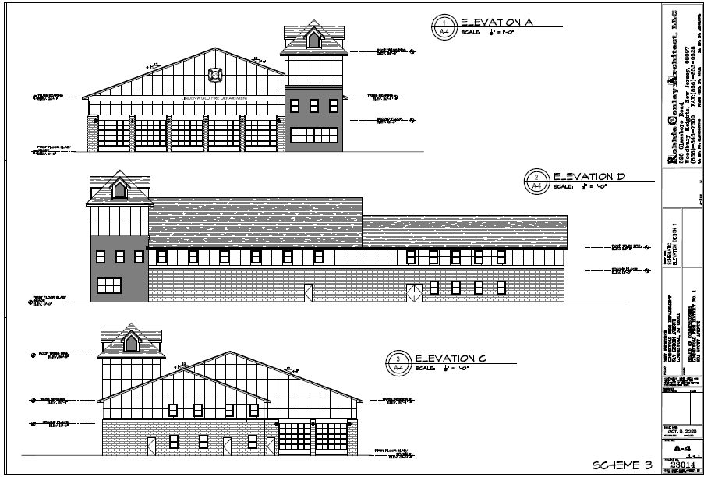
SCHEME 3
SOLUTIONS

Slide 22
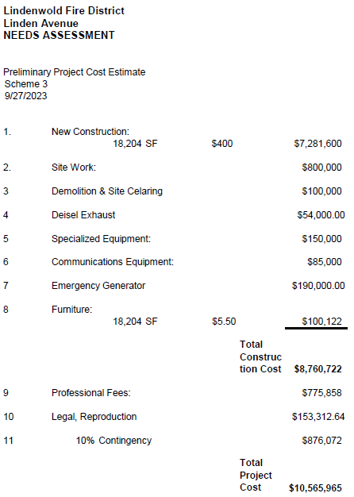
SCHEME 3
SOLUTIONS

Slide 23
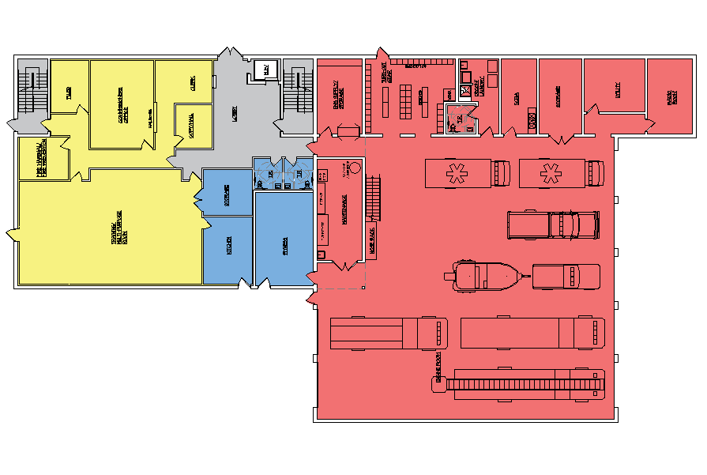
FIRST FLOOR
CONCLUSION

Slide 24
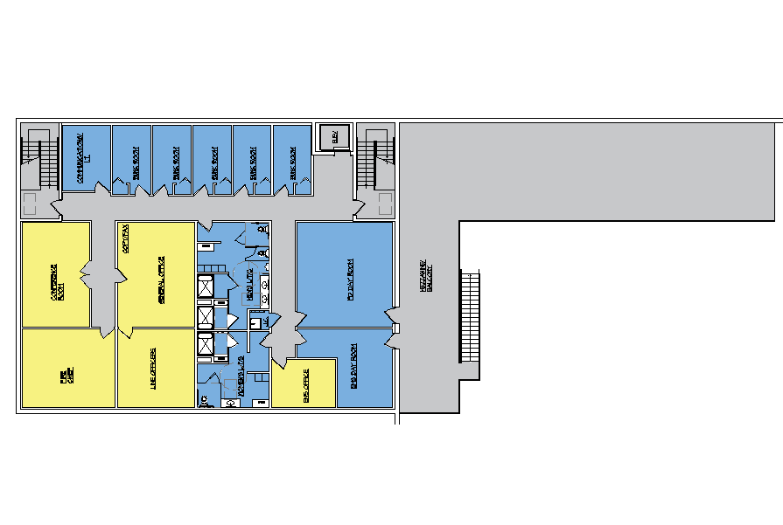
SECOND FLOOR
CONCLUSION

Slide 25
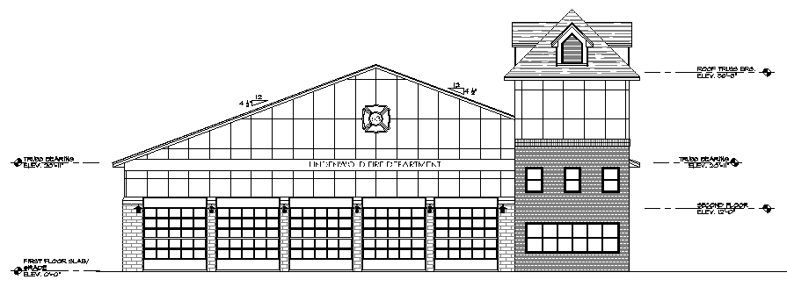
E LINDEN AVE ELEVATION
CONCLUSION

Slide 26
BERLIN RD S ELEVATION
CONCLUSION

Slide 27
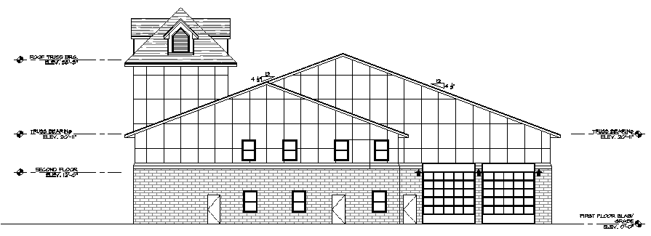
E ELM AVE ELEVATION
CONCLUSION

Slide 28
HAWTHORNE ST ELEVATION
CONCLUSION

Slide 29
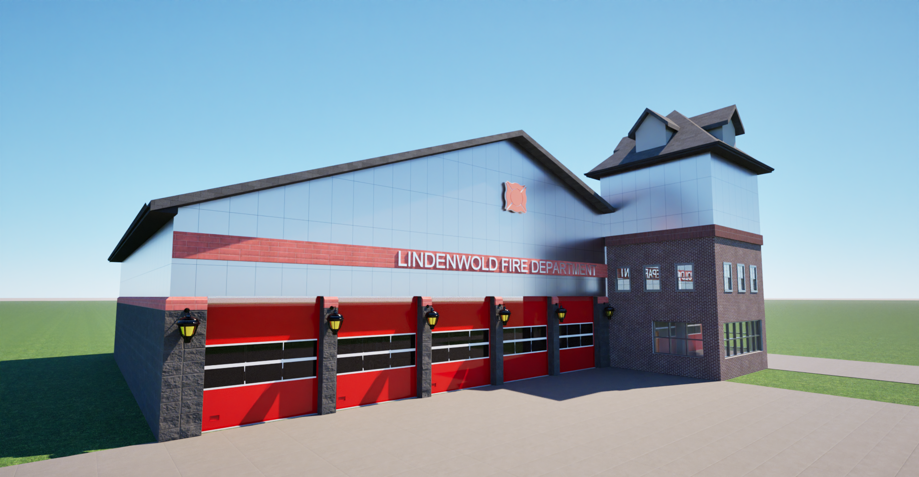
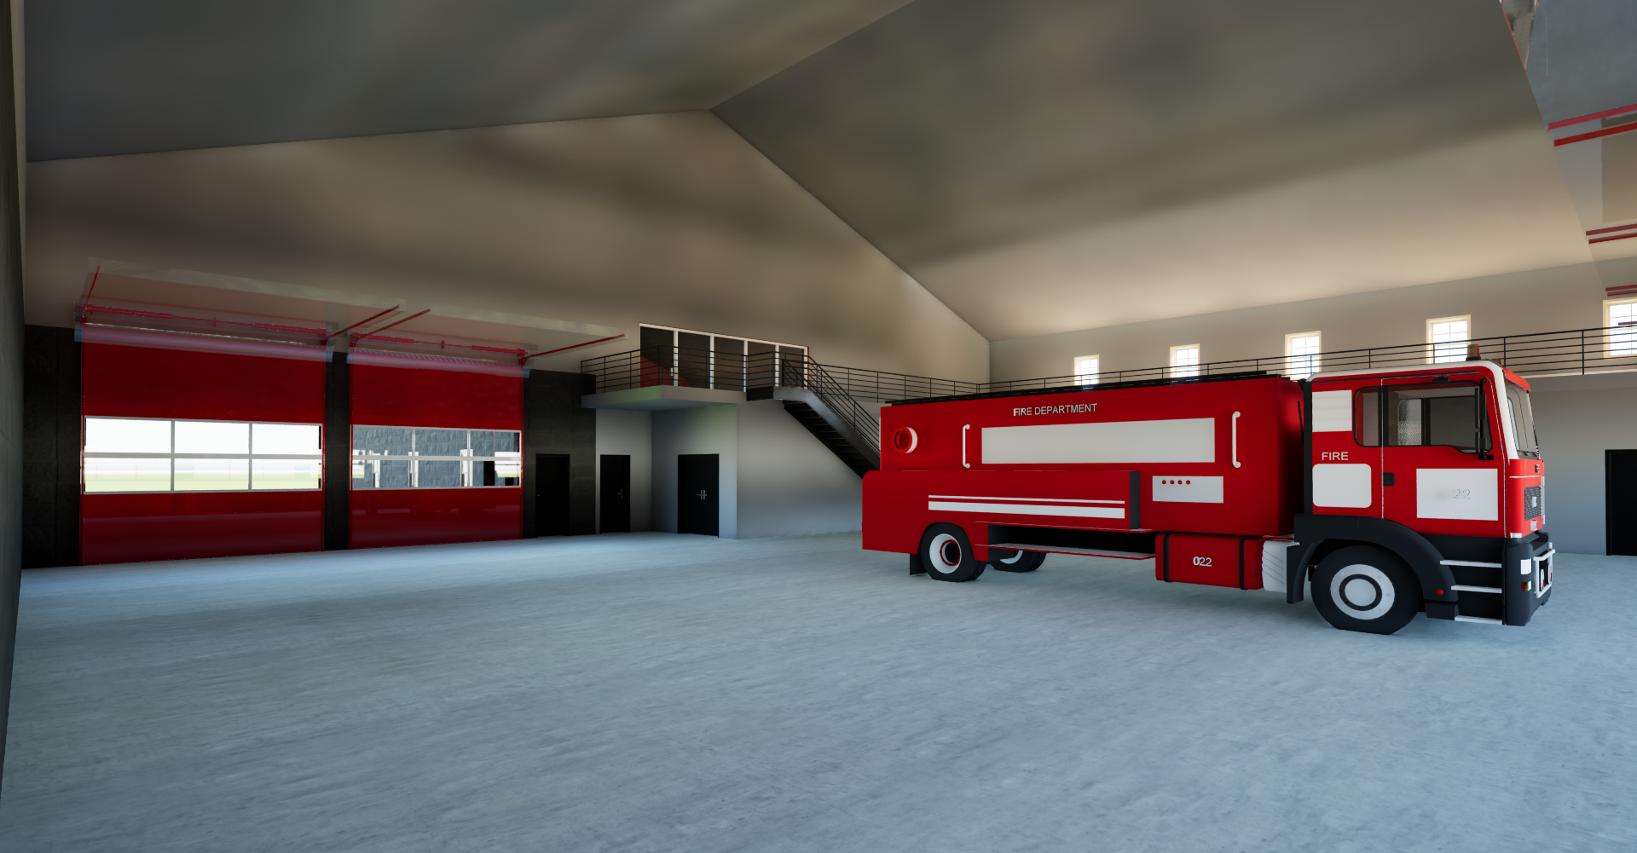
RENDERS
CONCLUSION

Slide 30
TAX IMPACT
Average Home $110,514 = $118.91 per year
Less than $10 /month
Less than $2.50 /week
Less than $.035 /day
< a week
CONCLUSION

Slide 31
Thank You Questions?
Robbie Conley, AIA PP John S. Descano, AIA PP

